Slide 1
Normalizing Flows
Mostafa Tavassolipour

Slide 2
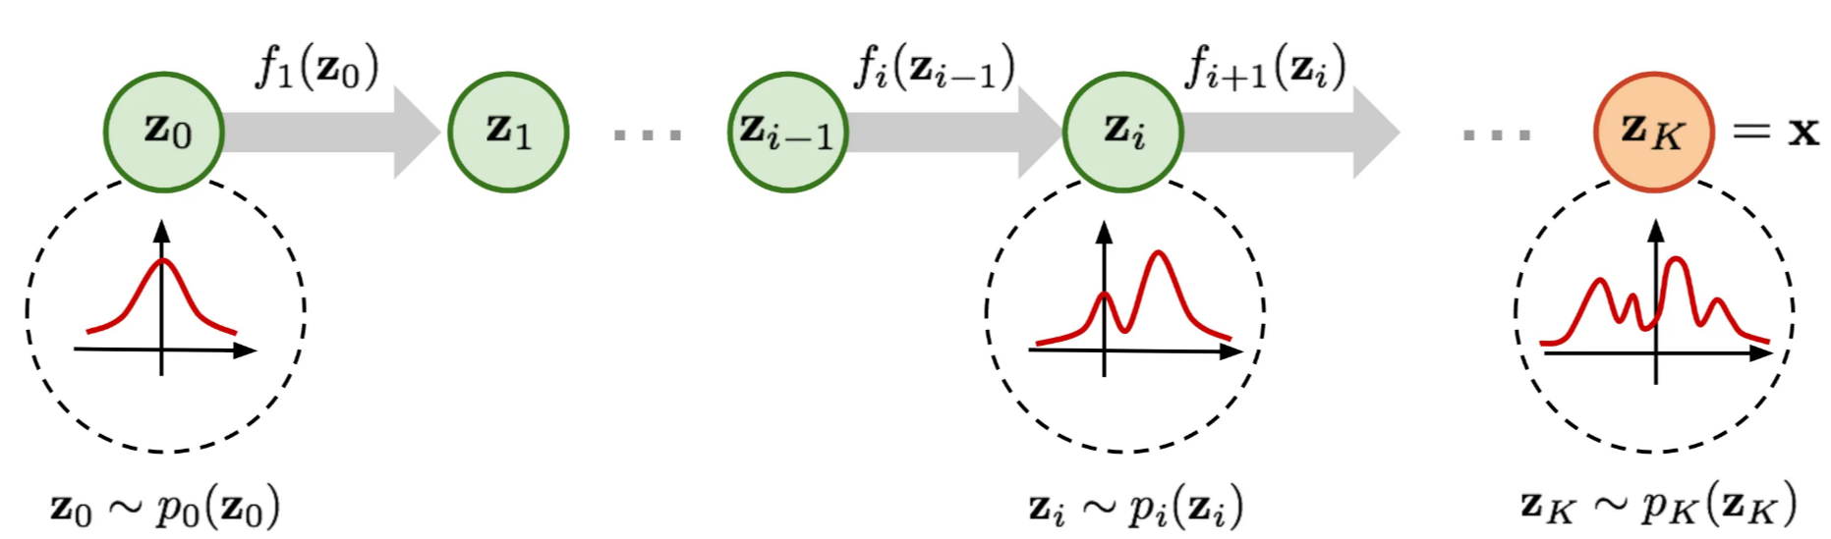
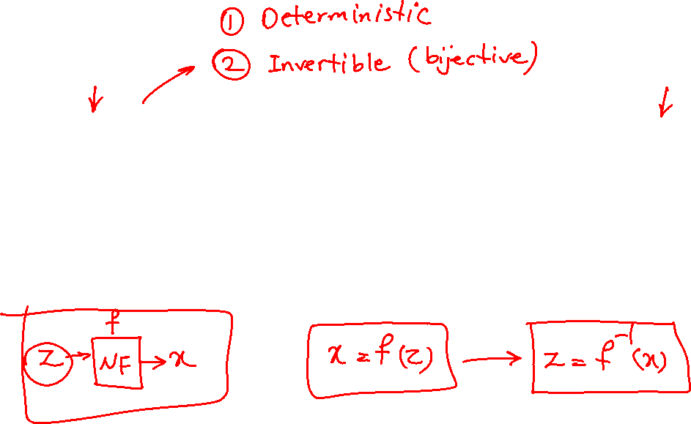
Normalizing Flows

Slide 3
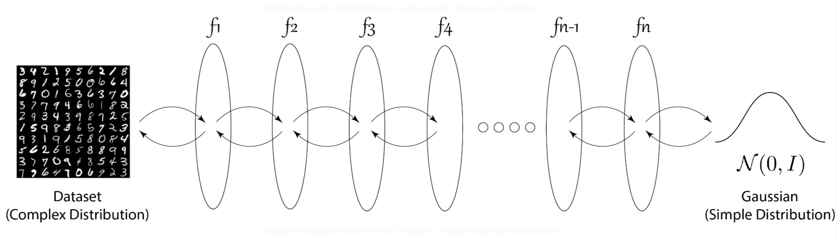
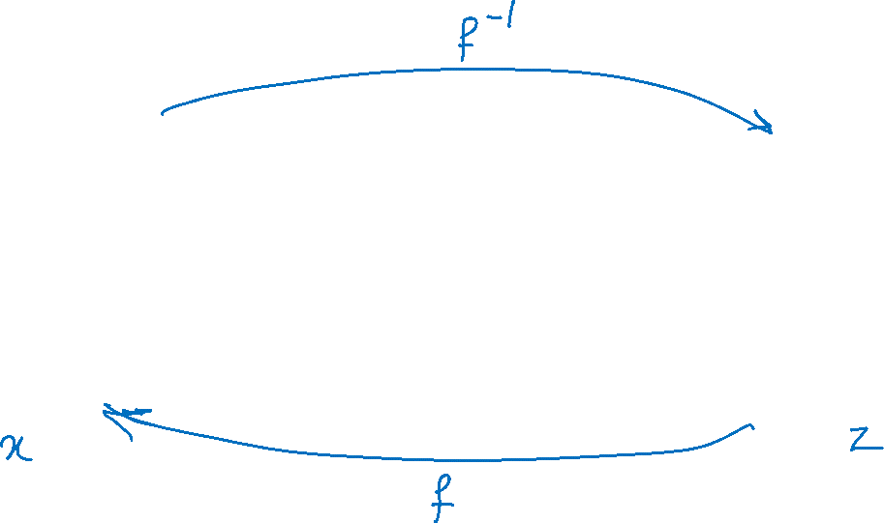
Example: MNIST Dataset

Slide 4
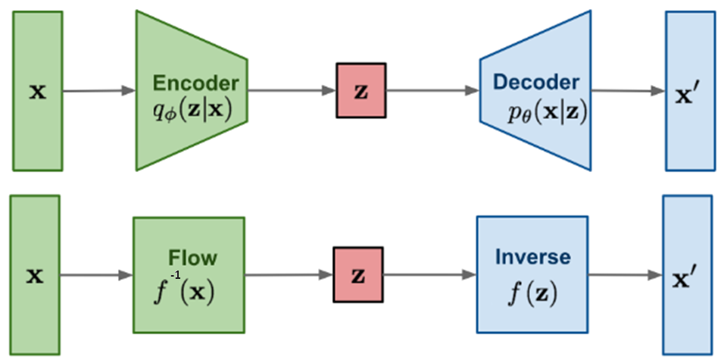

Normalizing Flows vs. VAE

Slide 5
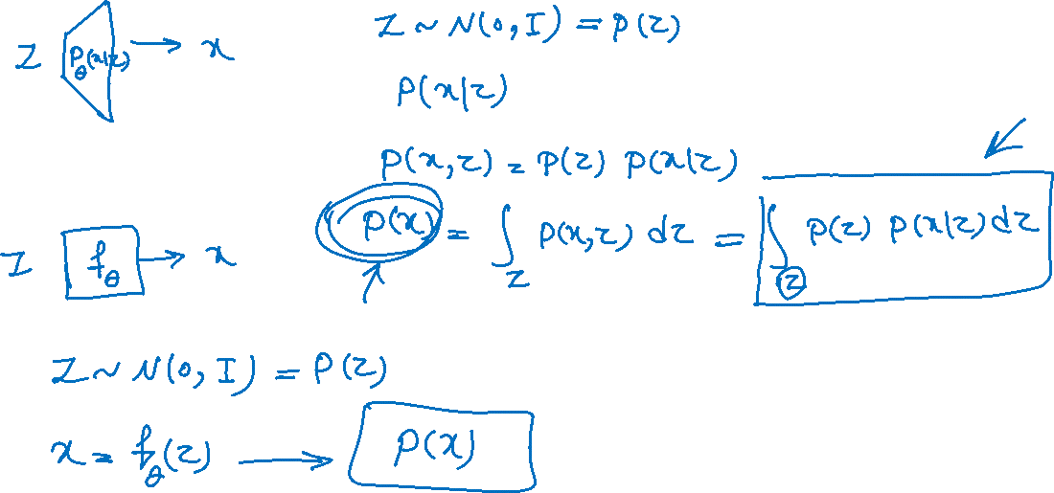
Marginal Likelihood: VAE vs NF

Slide 6
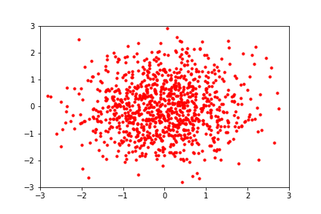
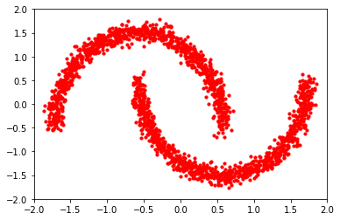
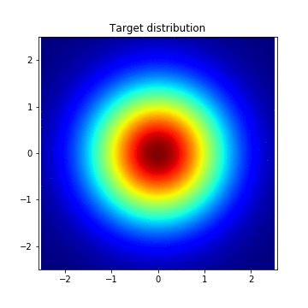
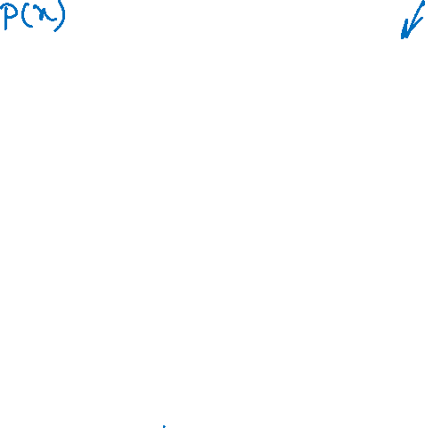
From Normal to Complex Distribution

Slide 7
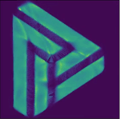
Normalizing Flow: another Example

Slide 8
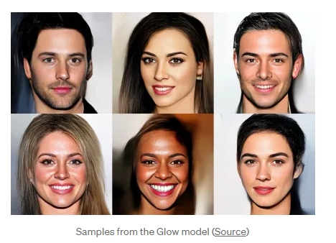

Samples from Normalizing Flow

Slide 9
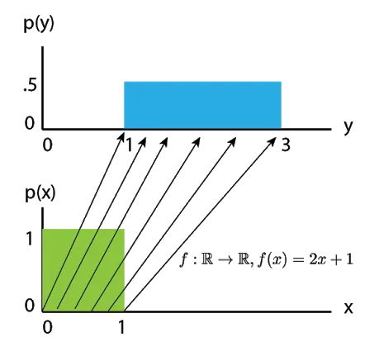
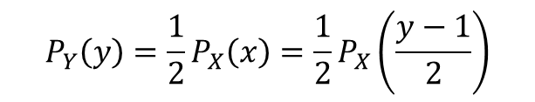
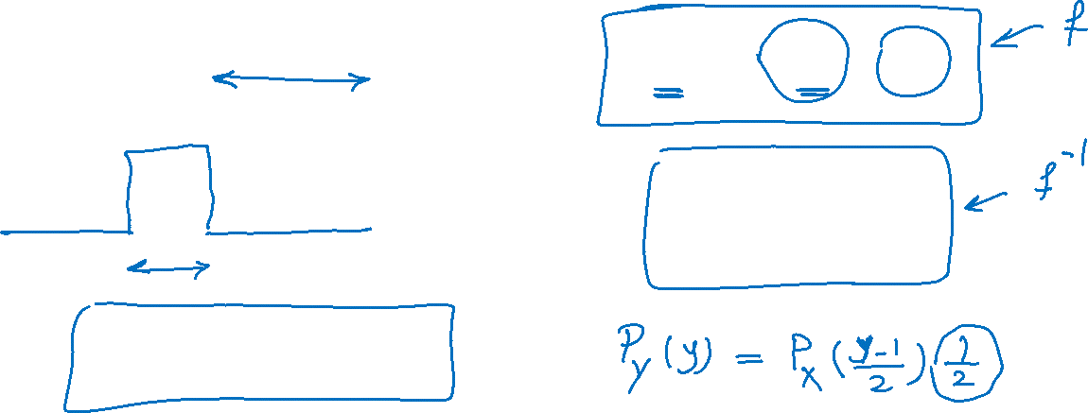
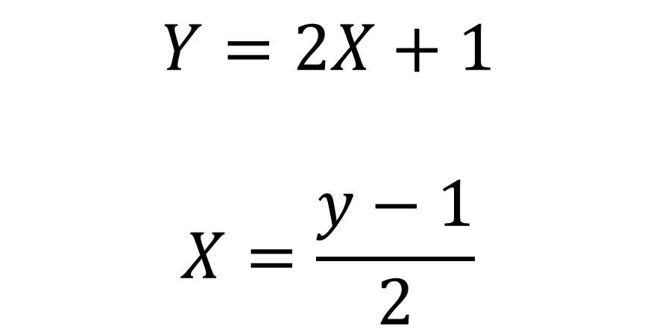
Change of Variable Formula
$$Y=2X+1$$
$$X=\frac{y−1}{2}$$
$$P_{Y}\left(y\right)=\frac{1}{2}P_{X}\left(x\right)=\frac{1}{2}P_{X}\left(\frac{y−1}{2}\right)$$

Slide 10
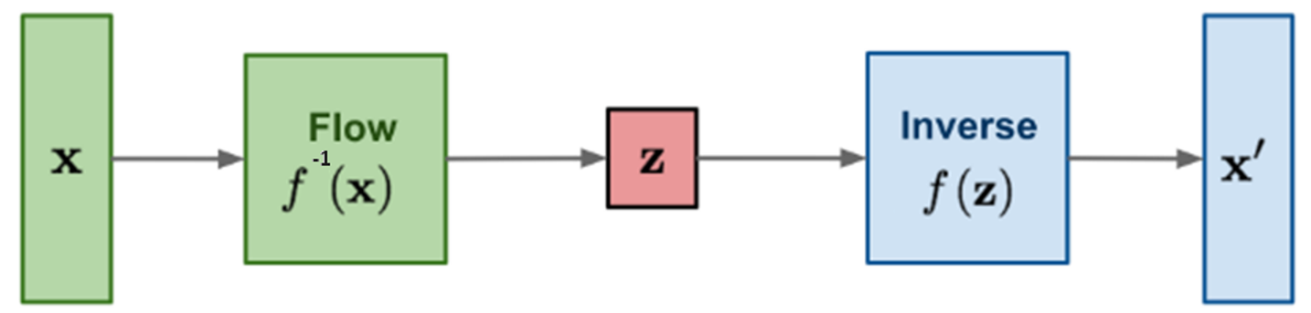
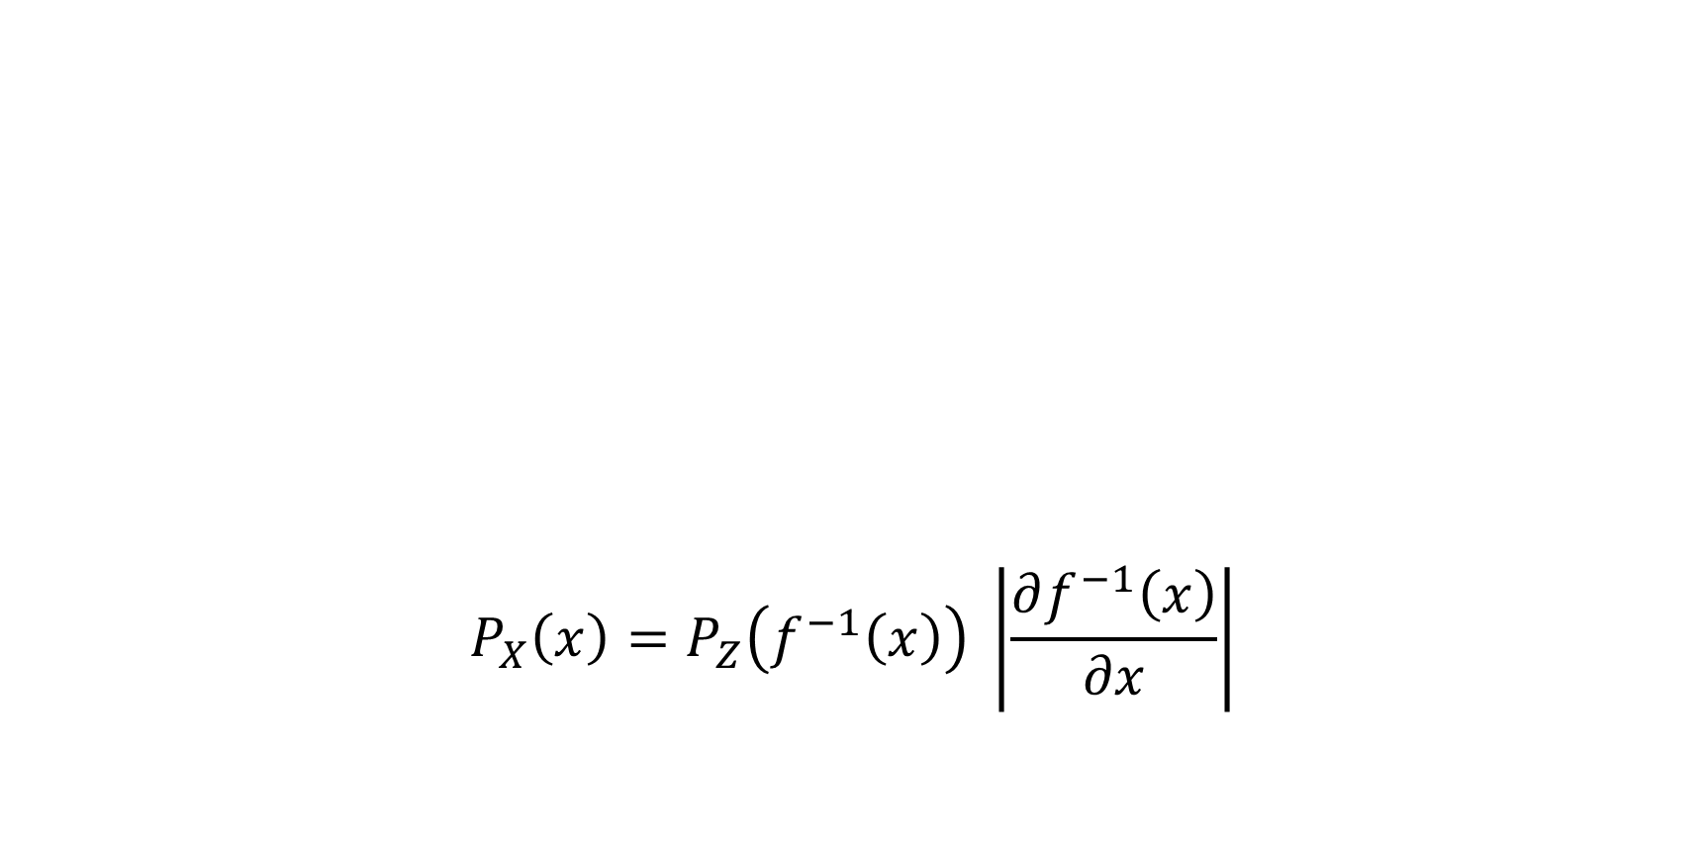
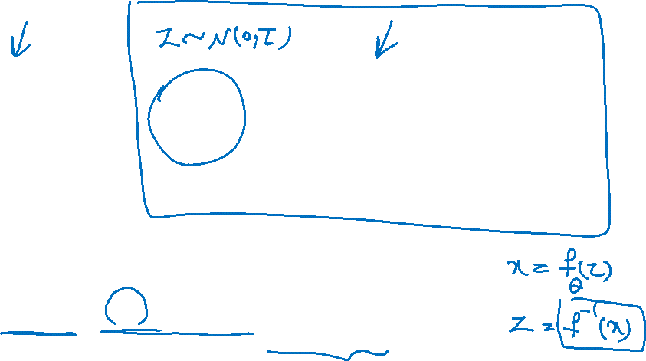
Change of Variable Formula: 1-Dimensional
$$P_{X}\left(x\right)=P_{Z}\left(f^{−1}\left(x\right)\right) \left|\frac{∂f^{−1}\left(x\right)}{∂x}\right|$$

Slide 11
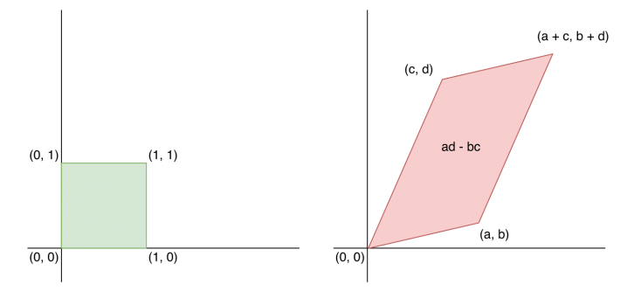
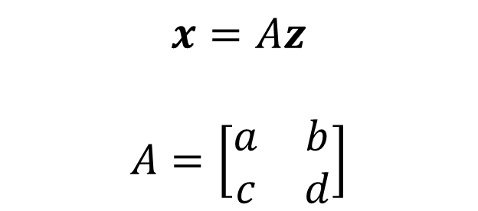
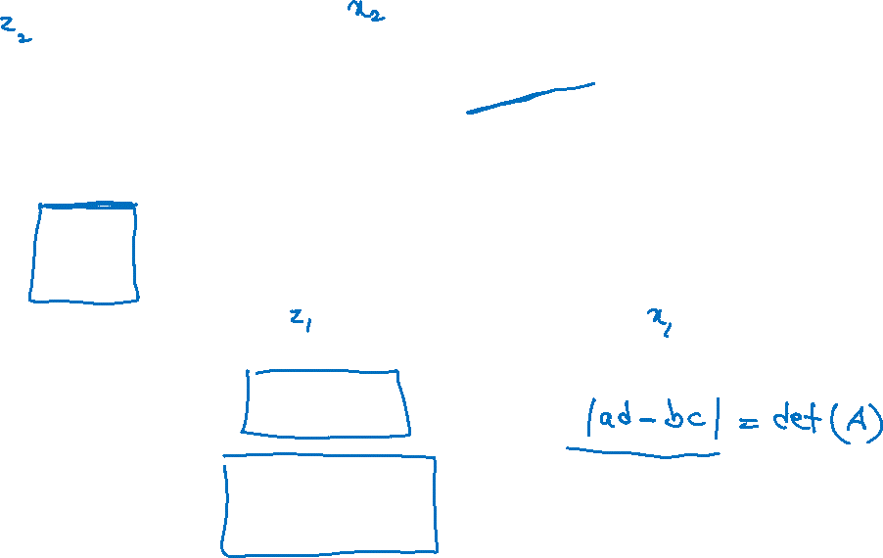
Change of variable: n-Dimensional
$$x=Az$$
$$A=\left[\begin{matrix}a & b \\ c & d\end{matrix}\right]$$

Slide 12
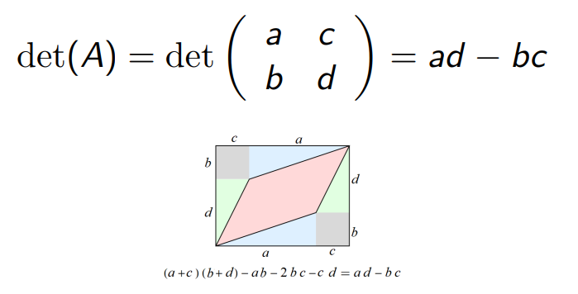
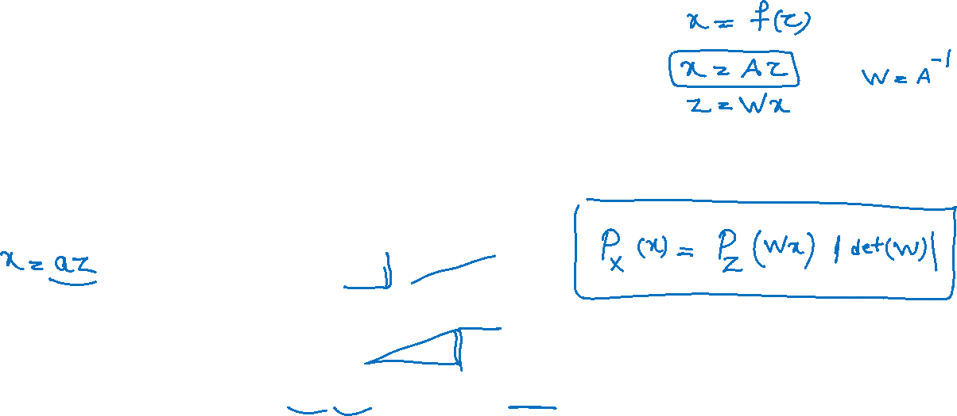
Determinants and Volume

Slide 13
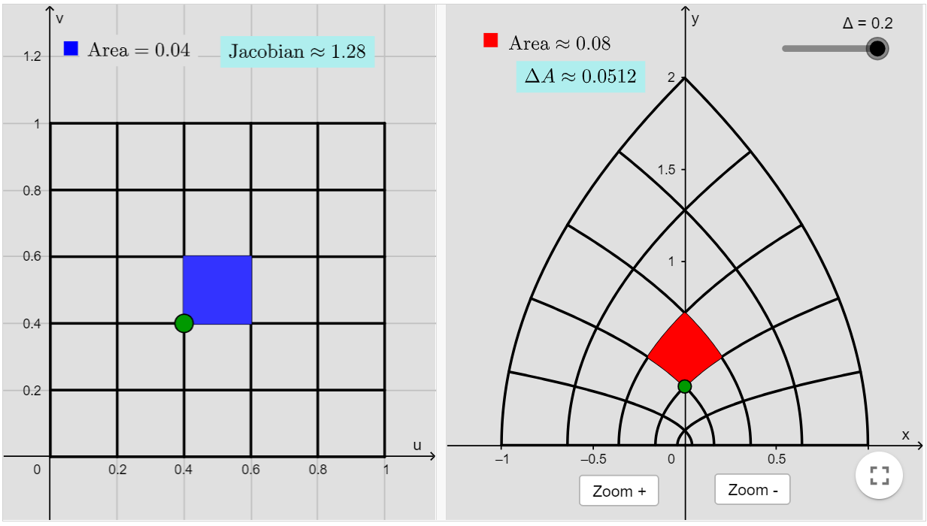
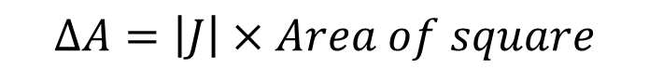
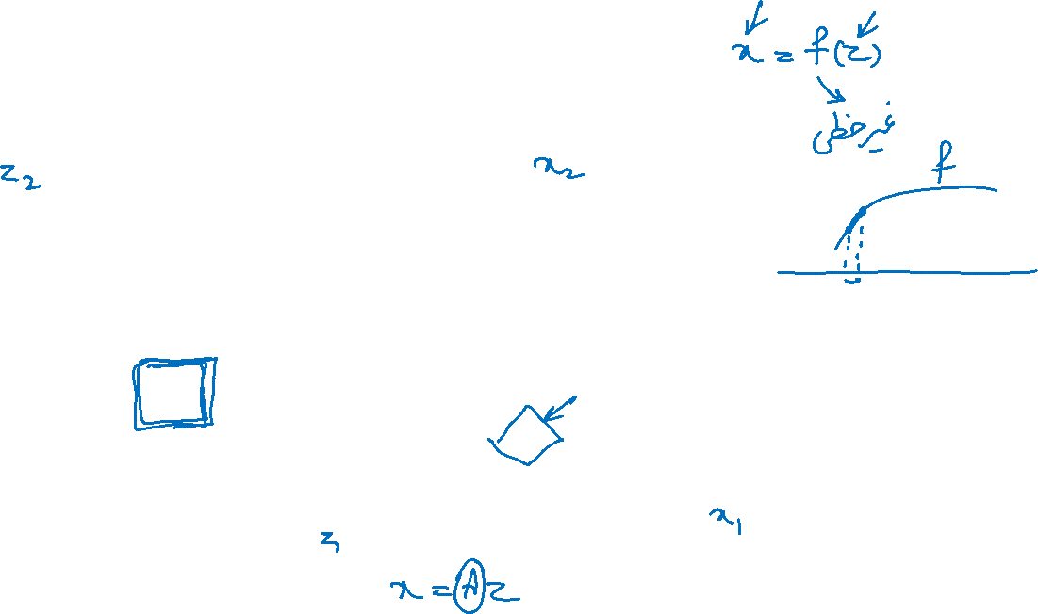
Jacobian Determinant
$$ΔA=\left|J\right|×Area of square$$
https://www.geogebra.org/m/qM777NYH

Slide 14
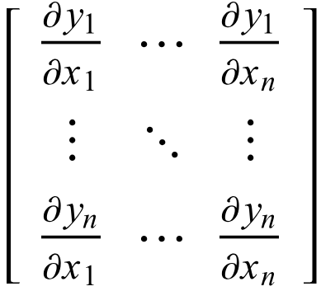
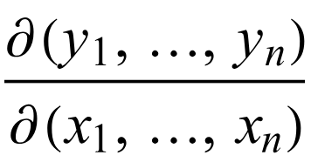
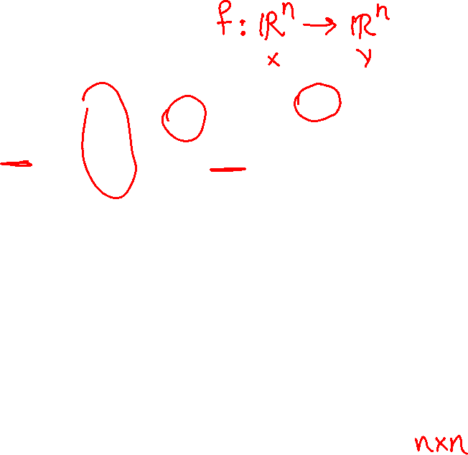
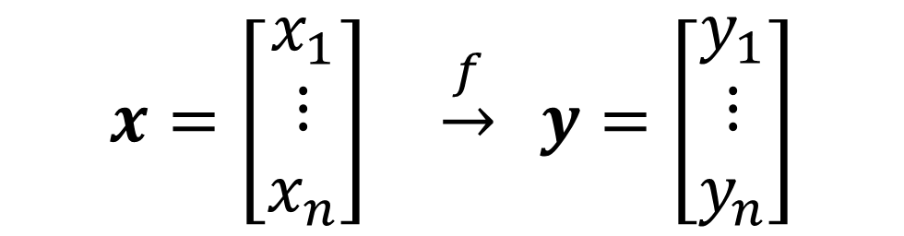
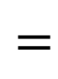
Jacobian Matrix
$$x=\left[\begin{aligned}x_{1} \\ ⋮ \\ x_{n}\end{aligned}\right] \underset{→}{f} y=\left[\begin{aligned}y_{1} \\ ⋮ \\ y_{n}\end{aligned}\right]$$
$$=$$

Slide 15
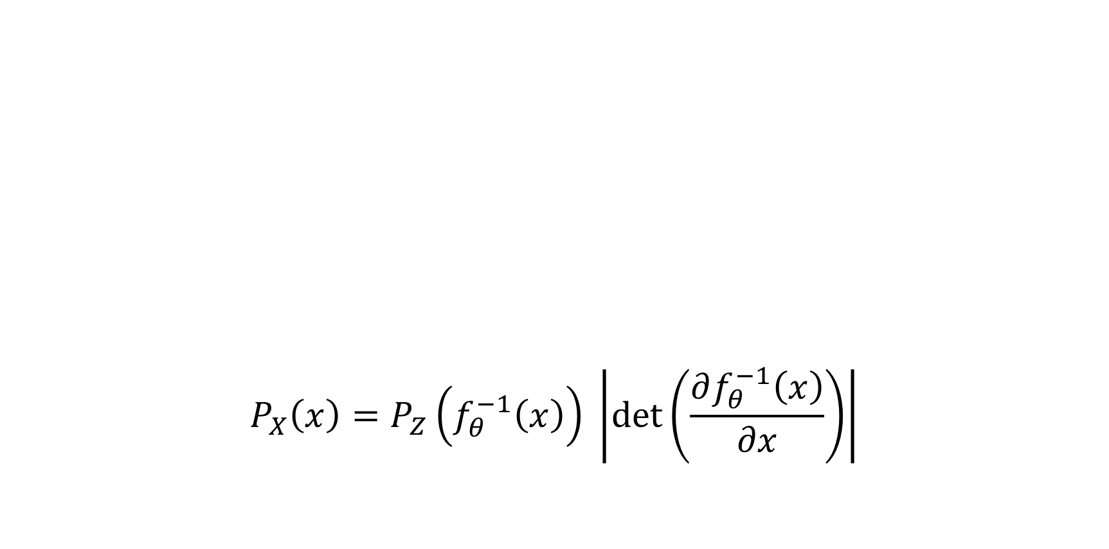
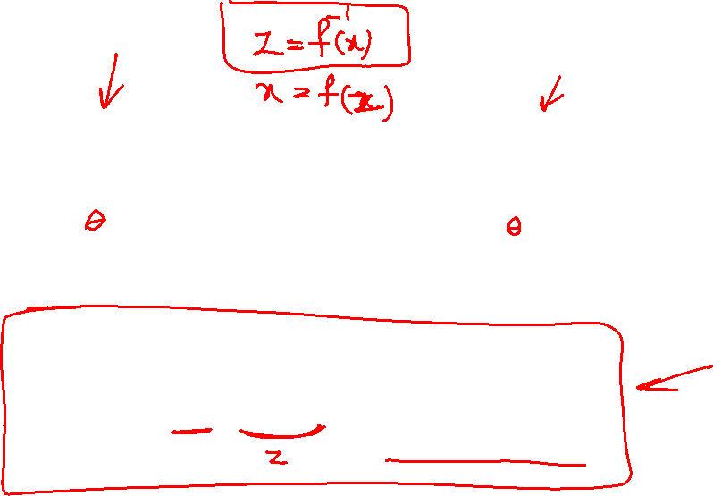
Change of Variable Formula: n-Dimensional
$$P_{X}\left(x\right)=P_{Z}\left(f_{θ}^{−1}\left(x\right)\right) \left|\det\left(\frac{∂f_{θ}^{−1}\left(x\right)}{∂x}\right)\right|$$

Slide 16
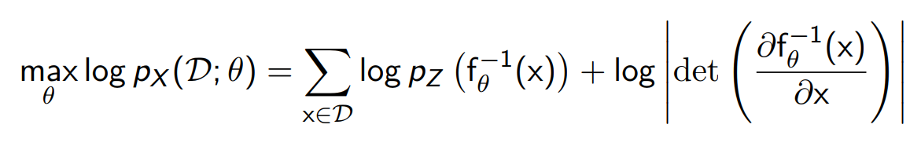
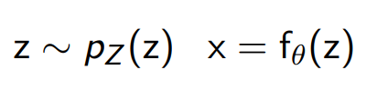
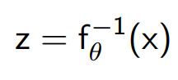
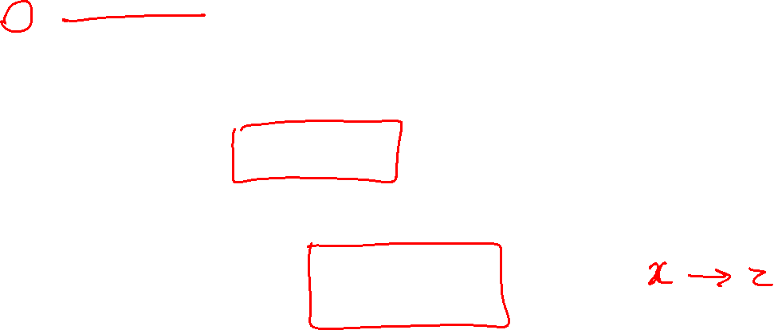
Learning and Inference
Learning via Maximum Likelihood:
Sampling:
Latent Representation:

Slide 17
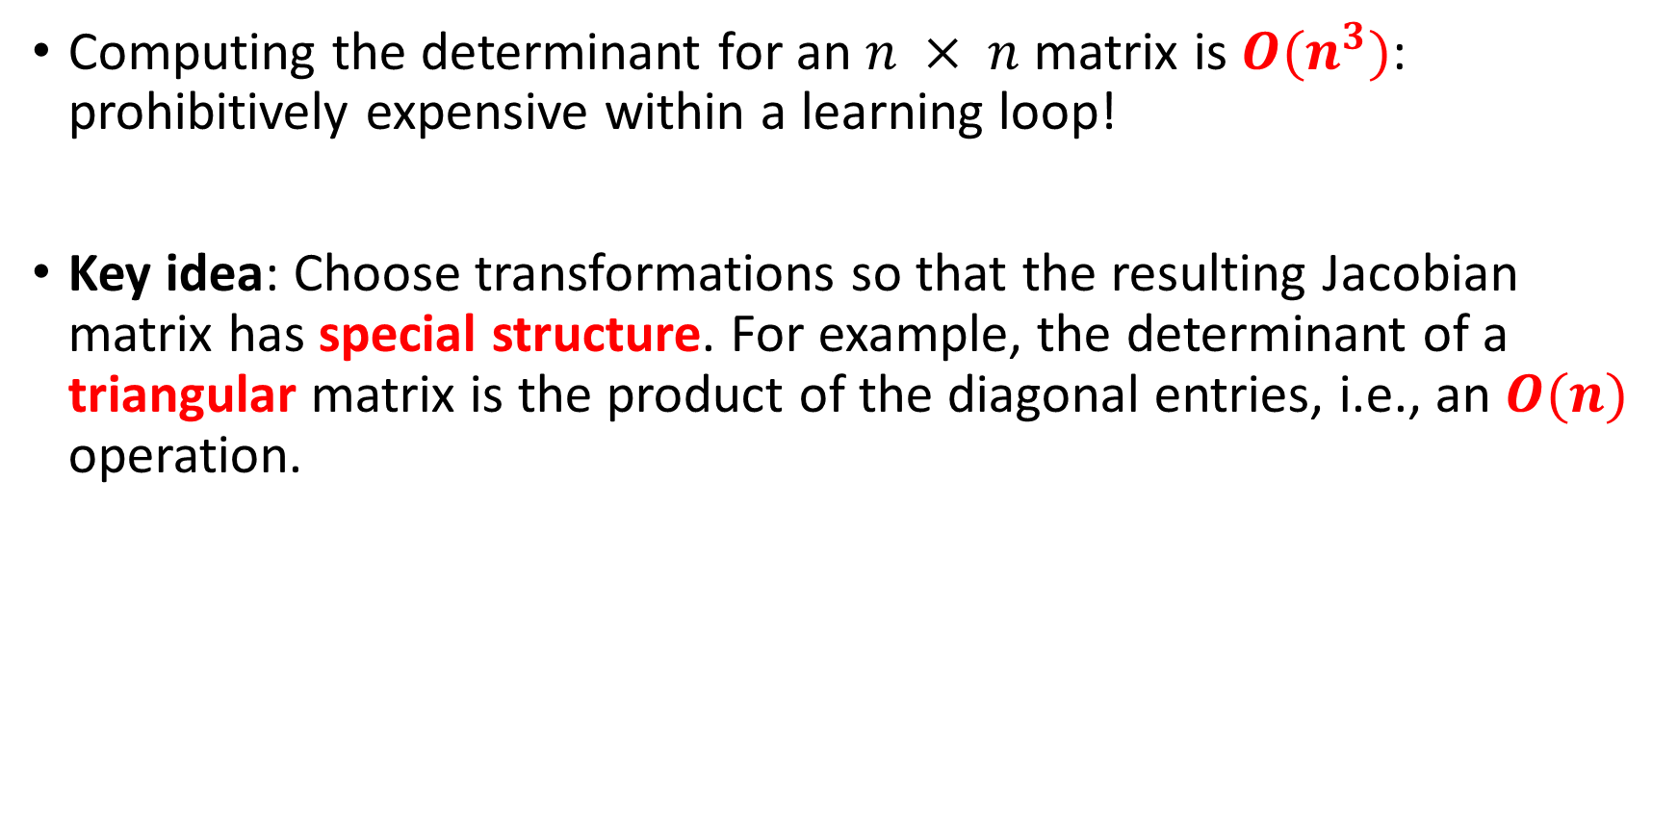
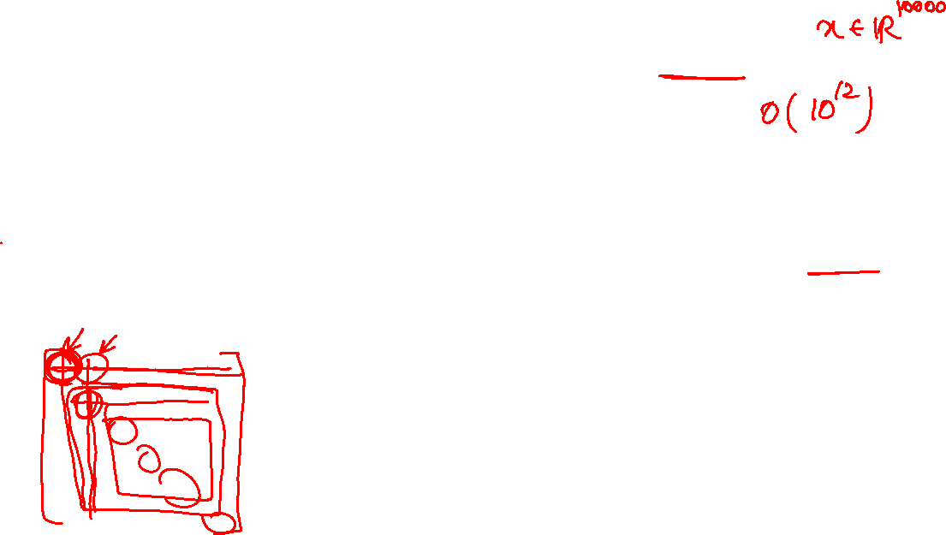
Calculation of the Determinant
Computing the determinant for an $n × n$ matrix is $O(n^{3})$: prohibitively expensive within a learning loop!
Key idea: Choose transformations so that the resulting Jacobian matrix has special structure. For example, the determinant of a triangular matrix is the product of the diagonal entries, i.e., an $O(n)$ operation.

Slide 18
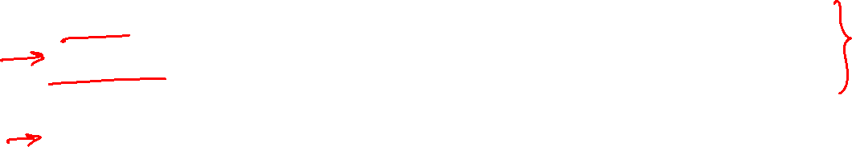
Models with Normalizing Flows
NICE (Non-linear Independent Component Estimation, 2015)
RealNVP (Real-valued Non-Volume Preserving, 2017)
Inverse Autoregressive Flow (Kingma et al., 2016)
Masked Autoregressive Flow (Papamakarios et al., 2017)
I-resnet (Behrmann et al, 2018)
Glow (Kingma et al, 2018)
MintNet (Song et al., 2019)
And many more

Slide 19
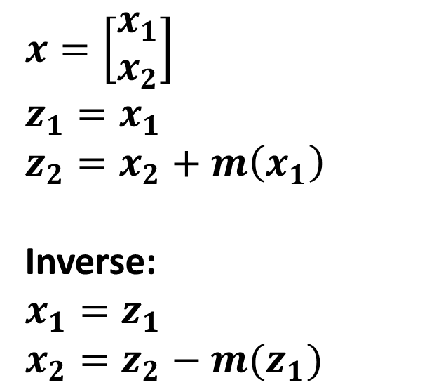
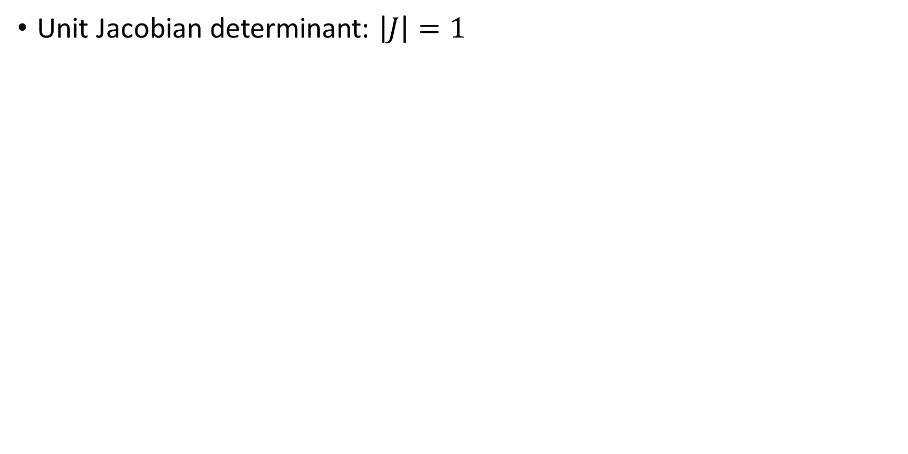
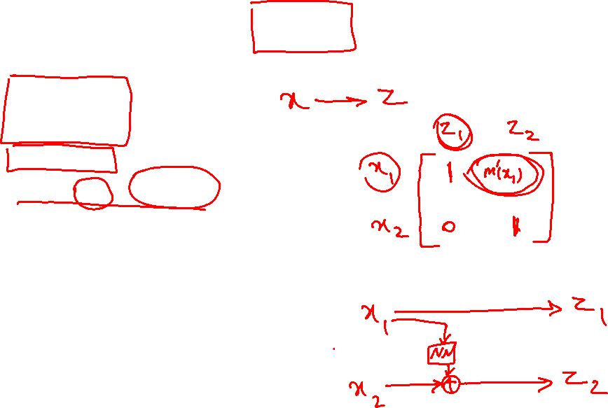
NICE
Unit Jacobian determinant: $\left|J\right|=1$
$$x=\left[\begin{aligned}x_{1} \\ x_{2}\end{aligned}\right]$$
$$z_{1}=x_{1}$$
$$z_{2}=x_{2}+m\left(x_{1}\right)$$
Inverse:
$$x_{1}=z_{1}$$
$$x_{2}=z_{2}−m(z_{1})$$

Slide 20
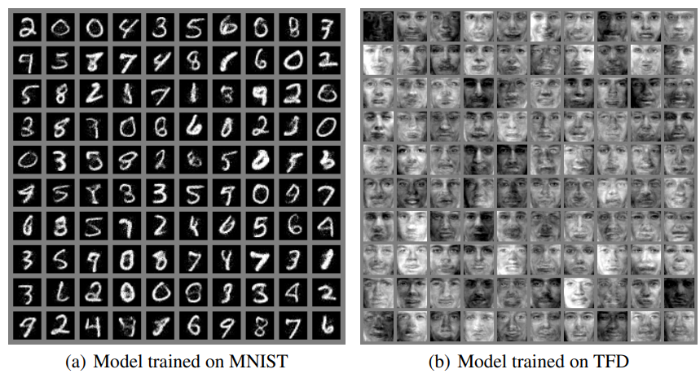
NICE: Results

Slide 21
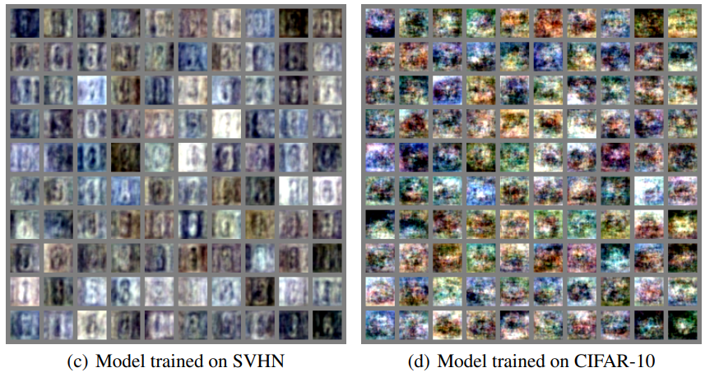
NICE: Results on Complex Data

Slide 22
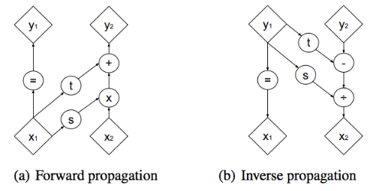
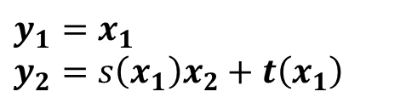
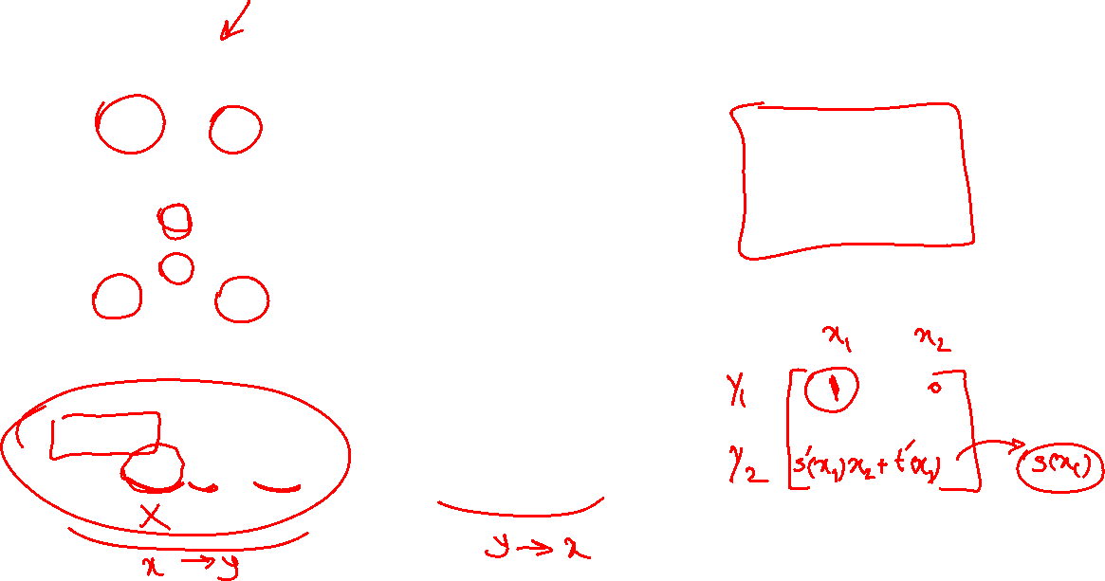
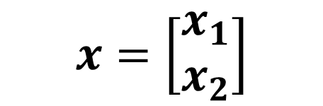

RealNVP
$$x=\left[\begin{aligned}x_{1} \\ x_{2}\end{aligned}\right]$$
$$x_{1}=y_{1}$$
$$x_{2}=\frac{y_{2}−t\left(y_{1}\right)}{s\left(y_{1}\right)}$$
$$y_{1}=x_{1}$$
$$y_{2}=s\left(x_{1}\right)x_{2}+t\left(x_{1}\right)$$

Slide 23


RealNVP

Slide 24

Samples generated via Real-NVP

Slide 25

RealNVP: More Results
CIFAR-10
Imagenet (32x32)
Imagenet (64x64)
CelebA
LSUN

Slide 26

GLOW: Result on CelebA

Slide 27



GLOW: Interpolation

Slide 28

GLOW: Sample Generated Face

